Slide 1

Java Memory Management

Slide 2

When a program is being executed, separate areas of memory are allocated for each
  class
  interface
  object
  running method
1-<number>

Slide 3
Memory Allocation in Java
Call stack / runtime stack
  Used for method information while the method is being executed
    Local variables
    Formal parameters
    Return value
    Where method should return to
Heap
  Used for
    Static information (interfaces and classes)
    Instance information (objects)
1-<number>

Slide 4
call stack
Memory allocated to your program
objects in the heap
static space in the heap
1-<number>

Slide 5
Memory Allocation in Java
Example: What happens when an object is created by new, as in
Person friend = new Person(…);
  The reference variable has memory allocated to it on the call stack
  The object is created using memory in the heap
1-<number>

Slide 6

Call stack (runtime stack) is the memory space used for method information while a method is being run
When a method is invoked, a call frame (or activation record ) for that method is created and “pushed” onto the call stack
  All the information needed during the execution of the method is grouped together in the call frame
1-<number>

Slide 7

Return value
Local variables
Formal Parameters
Return address
1-<number>

Slide 8

A call frame contains:
  Address to return to after method ends
  Method’s formal parameter variables
  Method’s local variables
  Return value (if any)
Note that the values in a call frame are accessible only while the corresponding method is being executed!
1-<number>

Slide 9
public class CallStackDemo
{
public static void m2( )
{
System.out.println("Starting m2");
System.out.println("m2 calling m3");
m3();
System.out.println("m2 calling m4");
m4();
System.out.println("Leaving m2");
return;
}
public static void m3( )
{
System.out.println("Starting m3");
System.out.println("Leaving m3");
return;
}
Example: a Typical Calling Sequence
1-<number>

Slide 10
public static void m4( )
{
System.out.println("Starting m4");
System.out.println("Leaving m4");
return;
}
public static void main(String args[ ])
{
System.out.println("Starting main");
System.out.println("main calling m2");
m2( );
System.out.println("Leaving main");
}
}
1-<number>

Slide 11

Frame for m3
Frame for m2
Frame for m2
Frame for main
Frame for main
Frame for main
main calls m2
m2 calls m3
Frame for m4
Frame for m2
Frame for m2
Frame for m2
Frame for main
Frame for main
Frame for main
etc.
Return from m3
m2 calls m4
Return from m4
1-<number>

Slide 12
Call Stack for a Typical Calling Sequence
When the main method is invoked:
  A call frame for main is created and pushed onto the runtime stack
When main calls the method m2:
  A call frame for m2 is created and pushed onto the runtime stack
When m2 calls m3:
  A call frame for m3 is created and pushed onto the runtime stack
When m3 terminates, its call frame is popped off and control returns to m2
1-<number>

Slide 13
Call Stack for a Typical Calling Sequence
When m2 now calls m4:
  What happens next?
  What happens when m4 terminates?
What happens when m2 terminates?
What happens when main terminates? Its call frame is popped off and control returns to the operating system
1-<number>
Notes:
A call frame for m4 is created and pushed onto the runtime stack
When m4 terminates, its call frame is popped off and control returns to m2
Etc.

Slide 14

We will now look at some examples of what is in a call frame for a method
  First for simple variables
  Then for reference variables
1-<number>

Slide 15

public class CallFrameDemo1
{
public static double square(double n){
double temp;
temp = n * n;
return temp;
}
public static void main(String args[ ]) {
double x = 4.5;
double y;
y = square(x);
System.out.println("Square of " + x + " is " + y);
}
}
1-<number>

Slide 16
Call Frames – Example 1
Draw a picture of the call frames on the call stack:
What will be in the call frame for the main method?
  Address to return to in operating system
  Variable args
  Variable x
  Variable y
What will be in the call frame for the method square?
  Address to return to in main
  Variable n
  Variable temp
  Return value
1-<number>

Slide 17
Discussion
There will be a call frame on the call stack for each method called. So what other call frame(s) will be pushed onto the call stack for our example?
Which call frames will be on the call stack at the same time?
1-<number>
Notes:
Println
Main, square
Main, println

Slide 18

Static space: contains one copy of each class and interface named in the program
  Contains their static variables, and methods
Object space:
  Information is stored about each object:
    Value of its instance variables
    Type of object (i.e. name of class)
1-<number>

Slide 19

Now let's look at reference variables …
Memory is allocated in the heap area when an object is created using new
  The reference variable is put in the call frame on the runtime stack
  The object is created using memory in the heap
1-<number>

Slide 20
public class CallFrameDemo2 {
private static void printAll(String s1, String s2, String s3){
System.out.println(s1.toString( ));
System.out.println(s2.toString( ));
System.out.println(s3.toString( ));
}
public static void main(String args[ ]) {
String str1, str2, str3;
str1 = new String(“ string 1 ”);
str2 = new String(“ string 2 ”);
str3 = new String(“ string 3 ”);
printAll(str1, str2, str3);
}
}
Example: Call Frames- Reference Variables
1-<number>

Slide 21
Call Frames – Example 2
Draw a picture of the call stack and of the heap as the program executes
What will be the sequence of call frames on the call stack?
for main
for String constructor for str1 – then popped off
for String constructor for str2 – then popped off
for String constructor for str3 – then popped off
for printAll
for toString for str1 – then popped off
for System.out.println – then popped off
etc.
1-<number>

Slide 22
Call Frames – Example 2
What will be in the call frame for main? (and in the heap?)
  Address to return to in operating system
  Variable args
  Variable str1
    Initially?
    After return from String constructor?
  Variable str2
  Variable str3
What will be in the call frame for printAll?
1-<number>

Slide 23

What happens when a method returns?
  On the runtime stack:
    The call frame is automatically popped off when the method returns
    So, that memory is deallocated
1-<number>

Slide 24
  What happens to objects on the heap?
    An object stays on the heap even if there is no longer a variable referencing it!
    So, Java has automatic garbage collection
      It regularly identifies objects which no longer have a variable referencing them, and deallocates that memory
1-<number>

Slide 25

In Java, memory management is a vital process. It is managed by Java automatically.
The JVM divides the memory into two parts: stack memory and heap memory.
From the perspective of Java, both are important memory areas but both are used for different purposes.
The major difference between Stack memory and heap memory is that the stack is used to store the order of method execution and local variables while the heap memory stores the objects and it uses dynamic memory allocation and deallocation.

Slide 26

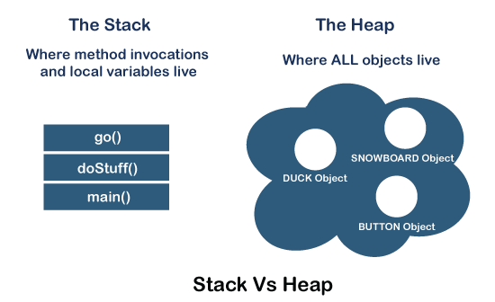

Slide 27

The stack memory is a physical space (in RAM) allocated to each thread at run time.
It is created when a thread creates.
Memory management in the stack follows LIFO (Last-In-First-Out) order because it is accessible globally. It stores the variables, references to objects, and partial results.
Memory allocated to stack lives until the function returns. If there is no space for creating the new objects, it throws the java.lang.StackOverFlowError. The scope of the elements is limited to their threads. The JVM creates a separate stack for each thread.

Slide 28

It is created when the JVM starts up and used by the application as long as the application runs.
It stores objects and JRE classes. Whenever we create objects it occupies space in the heap memory while the reference of that object creates in the stack. It does not follow any order like the stack.
It dynamically handles the memory blocks. It means, we need not to handle the memory manually.
For managing the memory automatically, Java provides the garbage collector that deletes the objects which are no longer being used.
Memory allocated to heap lives until any one event, either program terminated or memory free does not occur. The elements are globally accessible in the application. It is a common memory space shared with all the thread

Slide 29
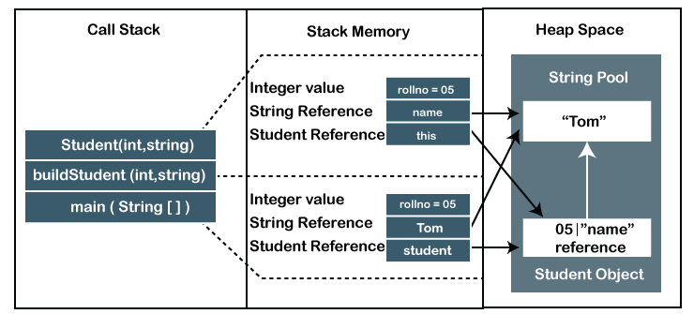

Slide 30
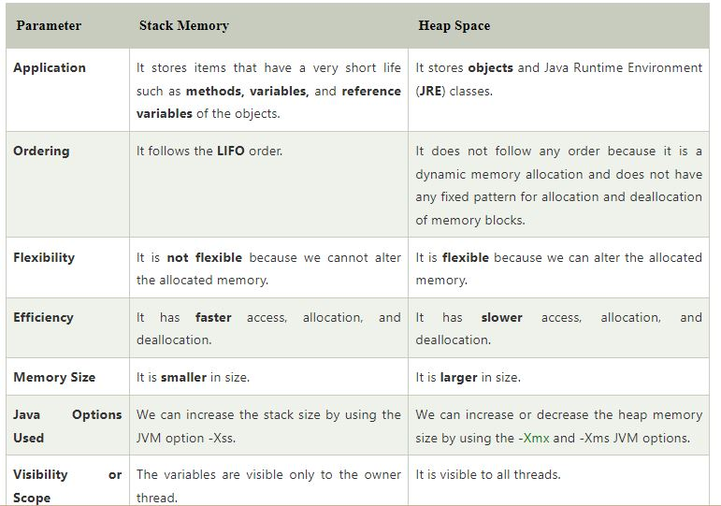

Slide 31
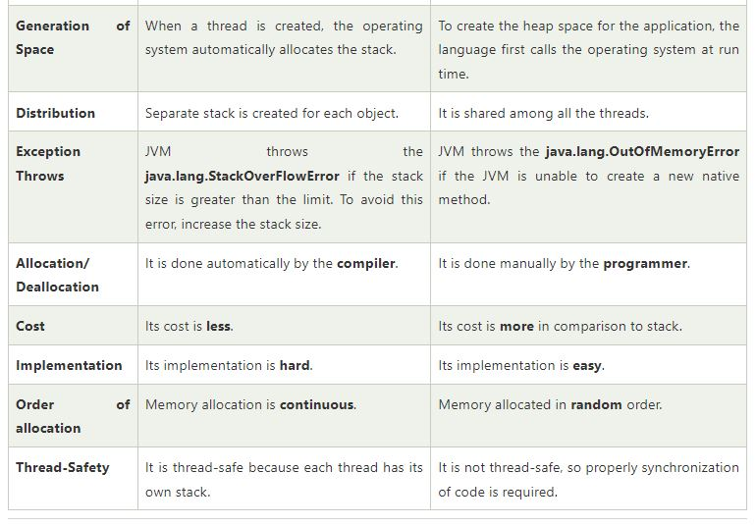

Slide 32

Memory Management technique.
Process of freeing objects.
No longer referenced by the program.

Slide 33

Free unreferenced objects.
Combat heap fragmentation.
Relieves programmer from manual freeing the memory.
Helps in ensuring program integrity.
Disadvantages
  Extra Overhead.
  Less control over scheduling of CPU time.

Slide 34

Purpose
  Find and delete unreachable objects.
  Free space as much as possible.
When??
  GC is under control of JVM.
  One can request but no guarantees.
How??
  Discovery of unreachable objects.
  With the help of Algorithms.

Slide 35
Ways for making objects eligible for collection
  Nulling a reference
  Reassigning a reference variable
  Isolating a reference
Forcing garbage collection
  Methods available to perform GC
  Only requests and no demands
  Using Runtime.getRuntime().gc() method: Runtime class allows the application to interface with the JVM in which the application is running. Hence by using its gc() method, we can request JVM to run Garbage Collector.
  Using System.gc() method: System class contain static method gc() for requesting JVM to run Garbage Collector.

Slide 36

Just before destroying an object, Garbage Collector calls finalize() method on the object to perform cleanup activities. Once finalize() method completes, Garbage Collector destroys that object.
finalize() method is present in Object class with the following prototype.
protected void finalize() throws Throwable
Based on our requirement, we can override finalize() method for performing our cleanup activities like closing connection from the database.
  The finalize() method is called by Garbage Collector, not JVM. However, Garbage Collector is one of the modules of JVM.
  Object class finalize() method has an empty implementation. Thus, it is recommended to override the finalize() method to dispose of system resources or perform other cleanups.
  The finalize() method is never invoked more than once for any object.
  If an uncaught exception is thrown by the finalize() method, the exception is ignored, and the finalization of that object terminates.

Slide 37

All objects extend (inherit from) Object (see http://java.sun.com/j2se/1.5.0/docs/api/java/lang/Object.html).
The Object class has a number of especially interested methods (that are inherited by our classes) such as:
  clone
  equals
  getClass
  toString

Slide 38

Example:
  public String toString ( ) {
  return super.toString() + “blah blah blah”;
  }

Slide 39

Another boolean operator like ==, !=, <, >=, …
Syntax
  object instanceof Class_Name
  True if object is of type Class_Name (or true if object is a descendent of Class_name).
  False, otherwise.

Slide 40
(x instanceof Object)
  True for all objects
Recall Employee
  HourlyEmployee
  SalariedEmployee
  Ex. 1
    SalariedEmployee x = new SalariedEmployee();
    (x instanceof Object) //true
    (x instanceof Employee) //true
    (x instanceof SalariedEmployee) //true
    (x instanceof String)
      Won’t compile. “Inconvertible types.”
    (x instanceof HourlyEmployee)
      Won’t compile. “Inconvertible types.”

Slide 41
Example:
  Integer i = new Integer(12);
  Object o = i;
  //Won’t compile:
  //System.out.println( (i instanceof String) );
  //OK. Compiles. Runs. Returns false:
  System.out.println( (o instanceof String) ); //false
  System.out.println( (o instanceof Object) ); //true
  System.out.println( (o instanceof Integer) ); //true

Slide 42

Recall that the instanceof operator is true “up and down” the inheritance hierarchy.
We need something more specific.
getClass returns a representation of the class that was used with new to create the object
  Can be compared with == and !=
  Ex.
    if (object1.getClass() == object2.getClass())
      System.out.println( “same class.” );
    else
      System.out.println( “not the same class.” );

Slide 43

Recall that everything is a descendent of Object.
The equals method for Object is defined as:
  public boolean equals ( Object otherObject )
  To override this method, our equals method most be rewritten with the above heading. (Otherwise, Employee has both equals methods.)

Slide 44

public boolean equals ( Object other ) {
if (other==null) {
return false;
} else if (getClass() != other.getClass()) {
return false;
} else {
Employee tmp = (Employee)other; // ← what’s this called?
return ( name.equals( tmp.name )
&& hireDate.equals( tmp.hireDate ) );
}
}
Why can’t we use instanceof instead of getClass?

Slide 45

Define a class named Payment that contains a member variable of type double that stores the amount of the payment and appropriate accessor and mutator methods. Also create a method named paymentDetails that outputs an English sentence to describe the amount of the payment.
Next, define a class named CashPayment that is derived from Payment. This class should redefine the paymentDetails method to indicate that the payment is in cash. Include appropriate constructor(s).
Define a class named CreditCardPayment that is derived from Payment. This class should contain member variables for the name on the card, expiration date, and credit card number. Include appropriate constructor(s). Finally, redefine the paymentDetails method to include all credit card information in the printout.
Create a main method that creates at least two CashPayment and two CreditCardPayment objects with different values and calls paymentDetails for each.

Slide 46

Define a class named Document that contains a member variable of type String named text that stores any textual content for the document. Create a method named toString that returns the text field. Also include a method to set this value.
Next, define a class for Email that is derived from Document and includes member variables for the sender, recipient, and subject of an email message. Implement appropriate accessor and mutator methods. The body of the email message should be stored in the inherited variable text. Redefine the toString method to concatenate all text fields.
Similarly, define a class for File that is derived from Document and includes a member variable for the pathname. The textual contents of the file should be stored in the inherited variable text. Redefine the toString method to concatenate all text fields.
Finally, create several sample objects of type Email and File in you main method. Test your objects by passing them to the following method that returns true if the object contains the specified keyword in the text property.
  public static boolean ContainKeyword ( Document docObject,
  String keyword ) {
  if (docObject.toString().indexOf(keyword,0) >= 0) return true;
  return false;
  }

Slide 47
Create a class called Vehicle that has the manufacturer’s name (type String), number of cylinders in the engine (type int), and owner (type Person assumed to be already defined). Then, create a class called Truck that is derived from Vehicle and has the following additional properties:
  the load capacity in tons (type double)
  towing capacity in pounds (type int)
Be sure that you class has a reasonable complement of constructors, accessor and mutator methods, and suitably defined equals and toString methods. Write a program to test all of your methods.

Slide 48

The following is some code for a video game. First, there is an Alien class that represents monsters:
  public class Alien {
  public static final int Snake_Alien = 0;
  public static final int Ogre_Alien = 1;
  public static final int Marshmallow_Man_Alien = 2;
  public int type; //stores one of the three above types
  public int health; //0=dead; 100=full strength
  public String name;
  public Alien ( int type, int health, String name ) {
  this.type = type;
  this.health = health;
  this.name = name;
  }
  }
The code is not very object-oriented and does not support information hiding in the Alien class. Rewrite the code so that inheritance is used to represent the different types of aliens instead of the “type” parameter. This should result in deletion of the “type” parameter. Also rewrite the Alien class to hide the member variables and create a “getDamage” method for each derived class that returns the amount of damage the alien inflicts.

Slide 49

Next we have the AlienPack class that represents a band of aliens and how much damage they can inflict:
  public class AlienPack {
  private Alien aliens[];
  public AlienPack ( int numAliens ) {
  aliens = new Alien[ numAliens ];
  }
  public void addAlien ( Alien newAlien, in index ) {
  aliens[index] = newAlien;
  }
  public Alien[] getAliens ( ) {
  return aliens;
  }
  public int calculateDamage ( ) {
  int damage = 0;
  for (int i=0; i<aliens.length; i++) {
  if (aliens[i].type==Alien.Snake_Alien) damage += 10;
  else if (aliens[i].type==Alien.Ogre_Alien) damage += 6;
  else if (aliens[i].type==Alien.Marshmallow_Man_Alien) damage += 1;
  }
  return damage;
  }
  }
Rewrite the calculateDamage method to use getDamage and write a main method that tests the code.

